Slide 1
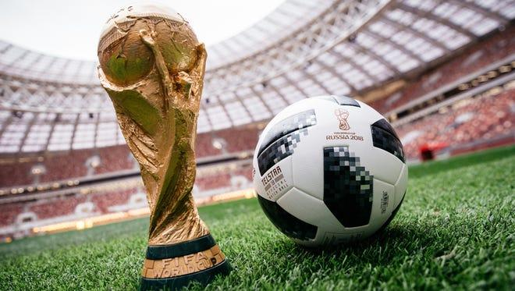
FIFA WORLD CUP ANALYSIS
FIFA WORLD CUP ANALYSIS
SOMIL TANEJA
Bradly John

Slide 2
INTRODUCTION
With FIFA is in the blood of many people of the world. You are tasked to tell the story of unsung analysts who put great efforts to provide accurate data to answer every question of fans. The FIFA World Cup is a global football competition contested by the various football-playing nations of the world. It is contested every four years and is the most prestigious and important trophy in the sport of football. The World Cups dataset shows all information about all the World Cups in history, while the World Cup Matches dataset shows all the results from the matches contested as part of the cups.

Slide 3
PROBLEM STATEMENT
With FIFA is in the blood of many people of the world. You are tasked to tell the story of unsung analysts who put great efforts to provide accurate data to answer every question of fans. The FIFA World Cup is a global football competition contested by the various football-playing nations of the world. It is contested every four years and is the most prestigious and important trophy in the sport of football.
The World Cups dataset shows all information about all the World Cups in history, while the World Cup Matches dataset shows all the results from the matches contested as part of the cups. Find key metrics and factors that influence the World Cup win. Do your own research and come up with your findings.

Slide 4
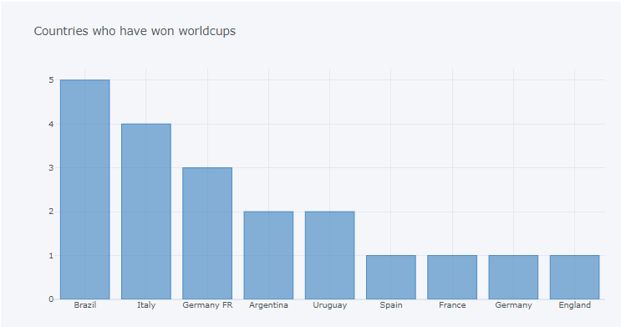
INSIGHTS
Brazil has won the tournament most number of times.

Slide 5
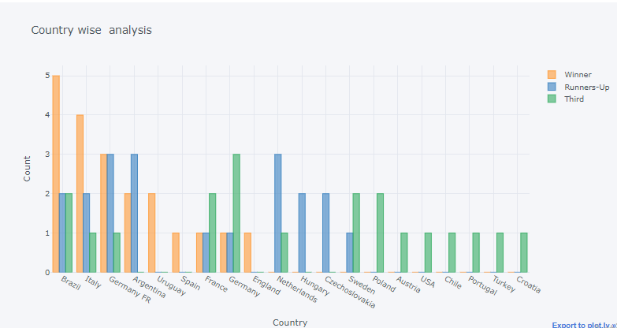
A complete depiction of number of world cups won, first runner-up, and second runner-up positions by various participating teams.

Slide 6
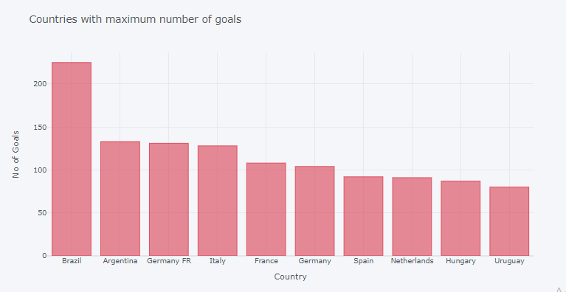
Brazil scored the most number of goals throughout the history of world cup followed by Argentina and Germany.

Slide 7
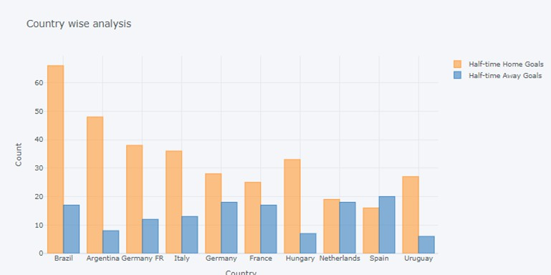
Brazil has scored a majority of total goals playing as home team whereas spain scored more goals playing as away country rather than home country.

Slide 8
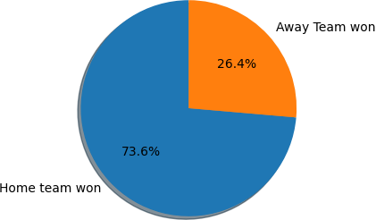
73.6 % of the matches were won by home team while 26.4 % were won by away team.

Slide 9
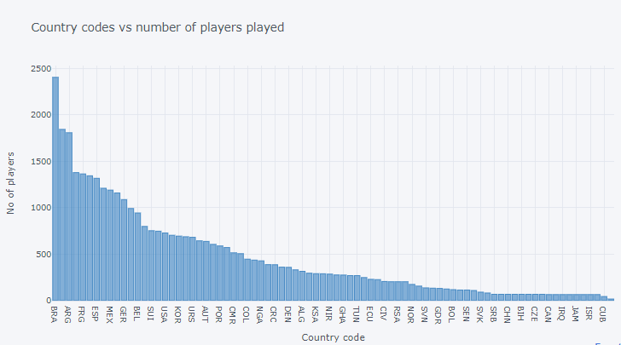
Brazil has played the most number of players followed by Italy and Argentina

Slide 10
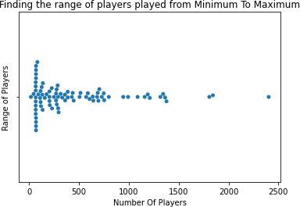
Most of the teams have played between 0 and 500 players only in the complete competition, and handful of countries have played more than 1500 players in the history of competition.

Slide 11


